Slide 1

Using Zoom AI Companion with zoom Mail Part 6

Slide 2

“I never realized how awkward it is to wave goodbye on Zoom until I accidentally muted myself while doing it.”

Slide 3




Notes:
https://www.youtube.com/channel/UC35ZpwldGw7ZJ5R-2sLijzw

Slide 4
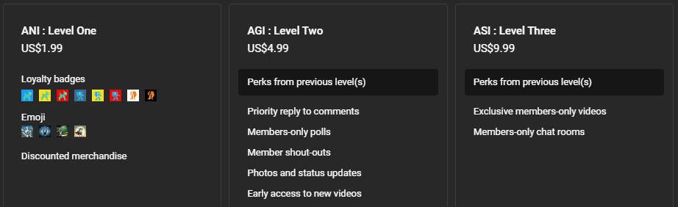

Membership has its privileges
Notes:
https://www.youtube.com/channel/UC35ZpwldGw7ZJ5R-2sLijzw/join

Slide 5

Notes:
https://support.zoom.com/hc/en/article?id=zm_kb&sysparm_article=KB0057623

Slide 6
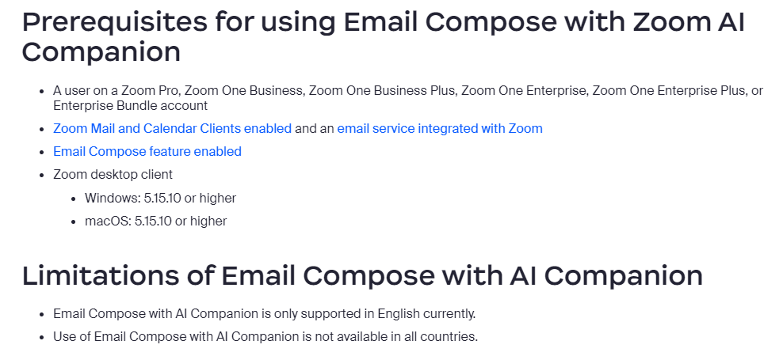
Notes:
https://support.zoom.com/hc/en/article?id=zm_kb&sysparm_article=KB0057662

Slide 7
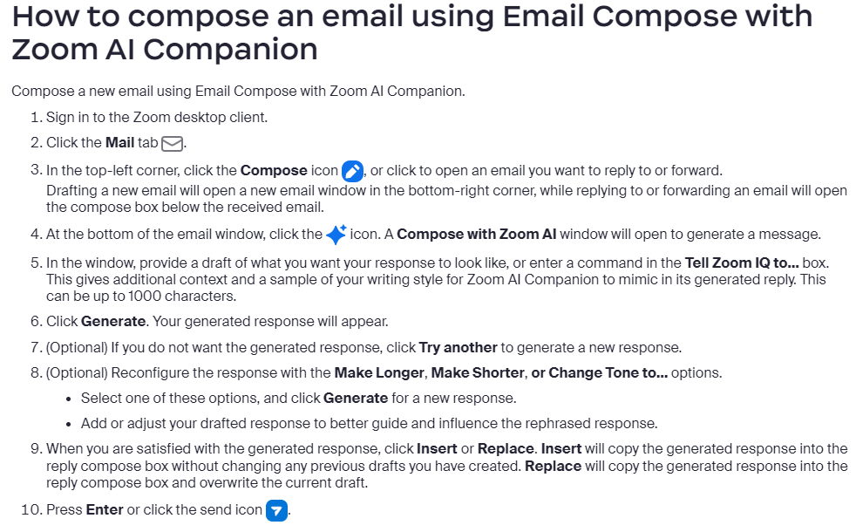
Notes:
https://support.zoom.com/hc/en/article?id=zm_kb&sysparm_article=KB0057662

Slide 8
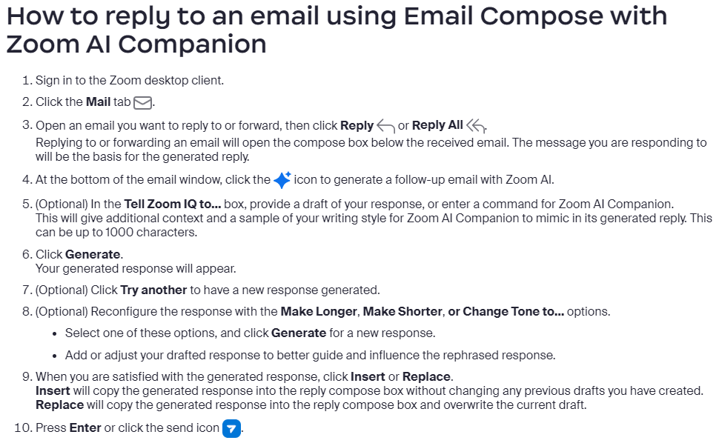

Slide 9
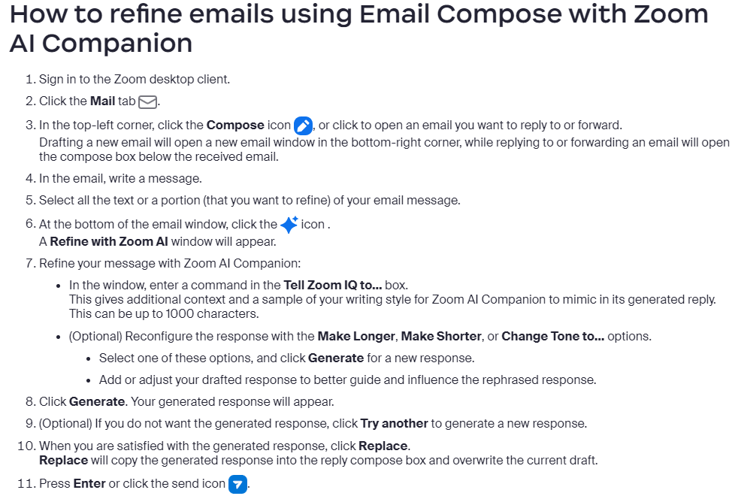

Slide 10
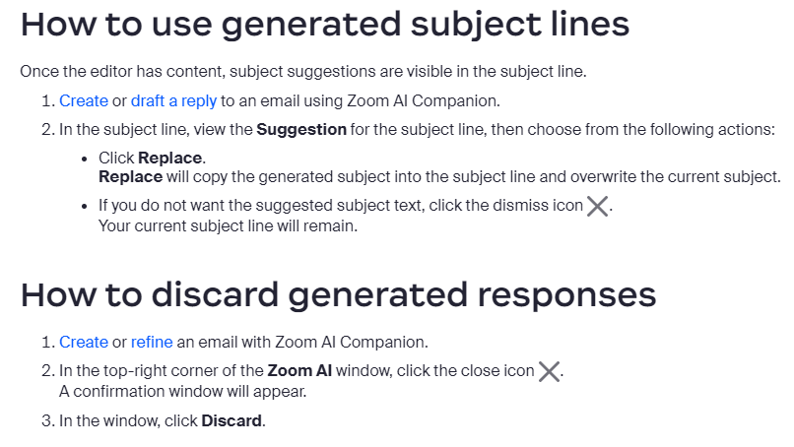

Slide 11
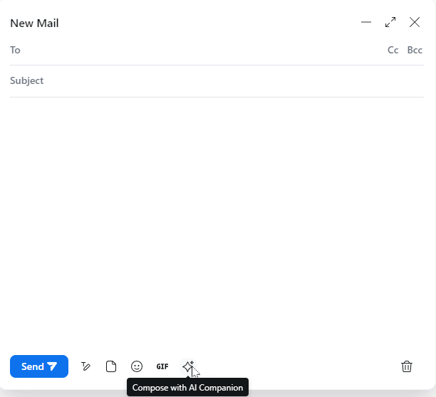
Demo: Creating emails with Email compose

Slide 12


